Slide 1
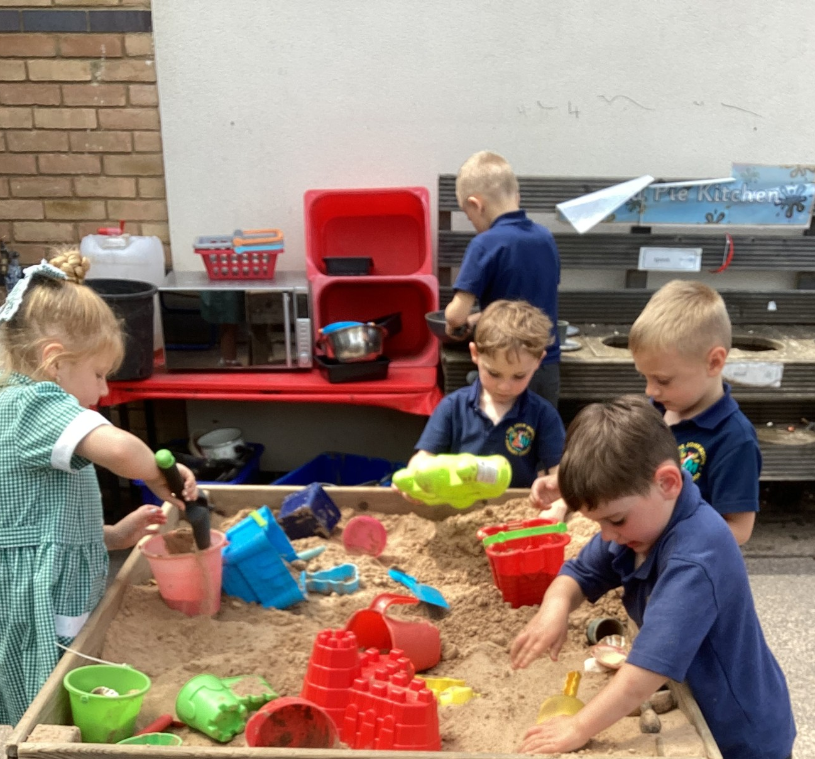
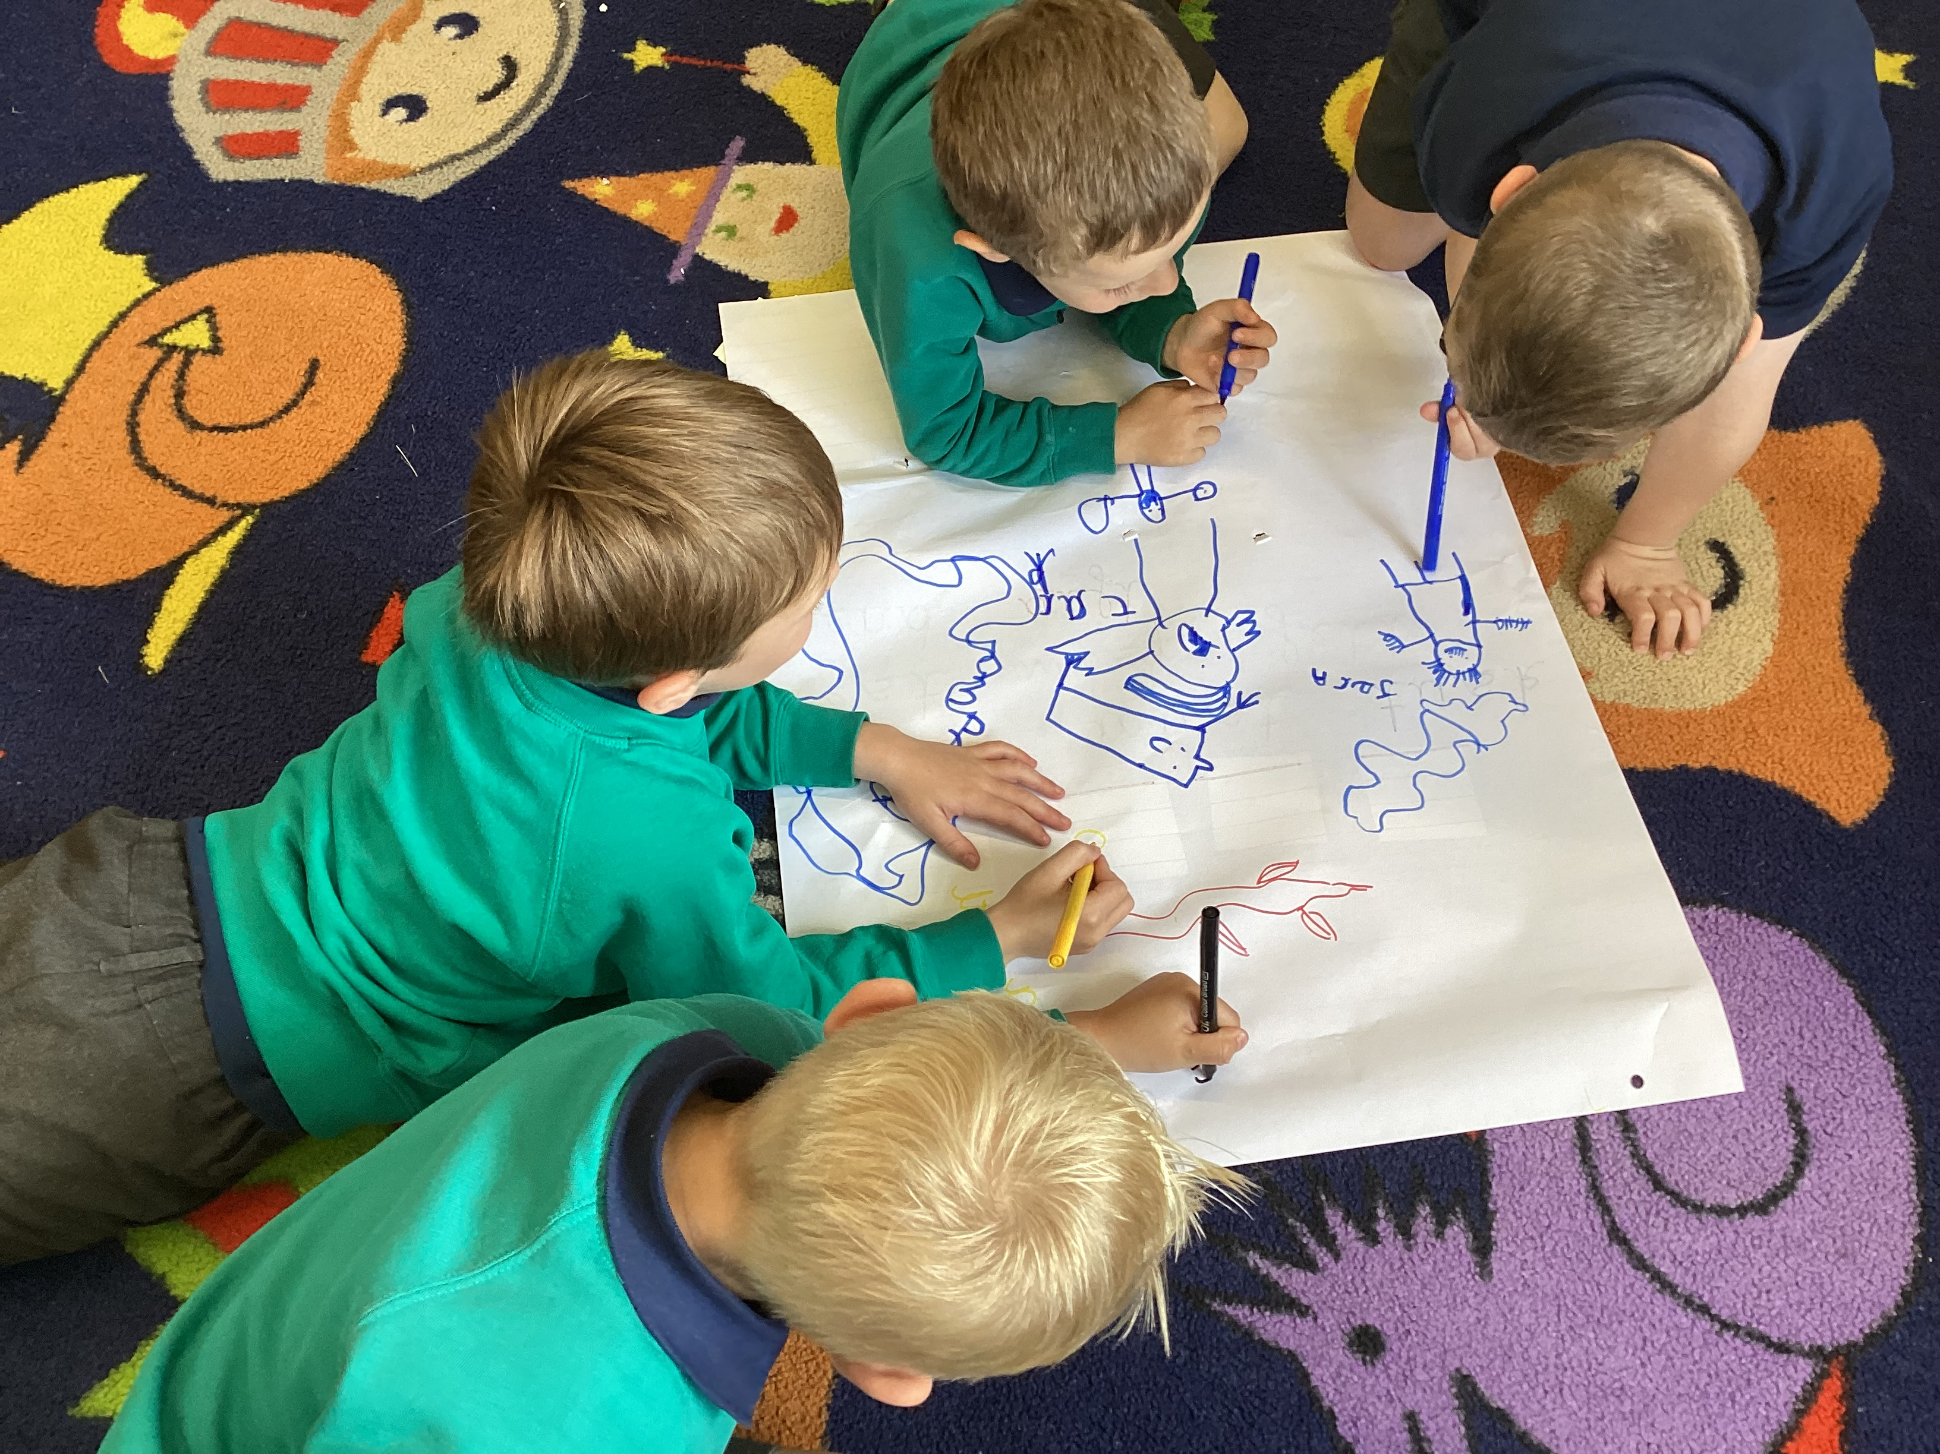
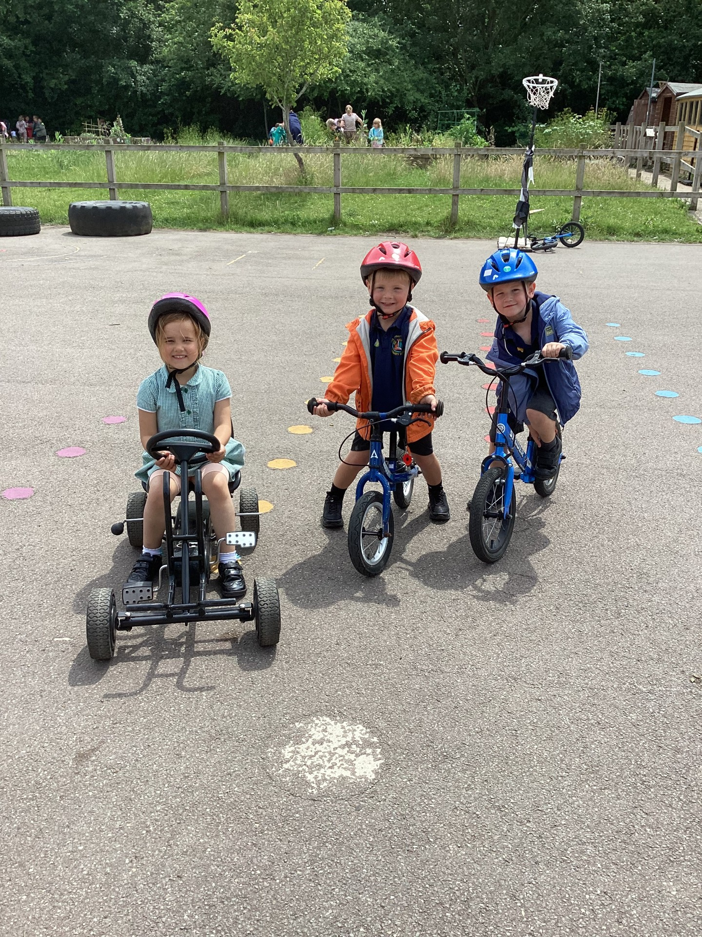


Welcome
Parents of
Foundation Stage Children

Slide 2
Introductions
Head Teacher: Mr Simon Lockley
Deputy Head Teacher: Mrs Sarah Hathaway
Inclusion Manager: Mrs Bronwen Williams
EYFS Lead: Mrs Catherine Hodgson
Child and Family Support Worker: Mrs Ali Stead

Slide 3
Finch Class
Class Teachers: Mrs Catherine Hodgson Teaching Partner: Mrs Jan James
Hummingbird Class:
Class Teacher: Mrs Vicky Parker
Teaching Partner: Mrs Tracy Moore
Robin Class:
Class Teachers: Miss Fran Hunt
Teaching Partner: Mrs Jo Russo

Slide 4


School Structure
EYFS/Year 1 - 3 mixed classes of 30
Year 2/Year 3 – 3 mixed classes of 30
Year 4/Year 5 – 3 mixed classes of 30
Year 6 – 2 smaller classes of 22/23

Slide 5
Transition visits
Two sessions in school on Wednesday 8th July (pm) and Monday 13th July (pm) 1.30-2.30pm
It will provide an opportunity to spend a short amount of time with the teacher and teaching partner in their classroom

Slide 6
How the transition is organised
Home Visits - afternoon of 2nd , 3rd and 4th September. Sign up on the sheet to book your appointment time or phone the office to add your time later. We will be bringing a gift for your child funded by the Friends of our school. The visit also provides an opportunity to discuss any concerns you may have’.
Starting school - The children will be into two groups
Why staggered?
Mornings or afternoons (then switch)
Morning (with the whole class)
Morning + lunch
Full time

Slide 7
First day routines
Arrive 7th September between 8:30-8.40am or 1:00pm Find their peg and drawer
Bring snacks into the classroom
Bring water bottle
Bring book bag
Unsettled children – please feel free to call us to check they have settled

Slide 8
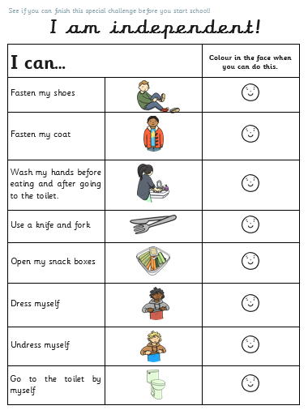
Activities to do at home
Put coat on & do it up
Turn clothes the right way round
Recognise name on clothing
Dress without help
Manage in the toilet
Wash hands
Make his/her needs known
Tidy toys away
Not necessary to write their name

Slide 9
Toilets
Foundation Stage toilets
Make sure that the children can use the toilet without help
Spare pants & socks in book bag
Encourage children to tell us if they have a problem
Ask to go...they will be allowed to go at any time!

Slide 10
Early Years Foundation Stage Curriculum
The Reception Year is a continuation and the final year of The Early Years Foundation Stage (EYFS)
7 Areas of Learning: Communication, Language,
Physical Development,
Personal, Social & Emotional,
          Literacy,
Mathematics,
Understanding the World,
Expressive Arts & Design,
Practical Activities
Electronic Learning Journeys – via Tapestry & Reach More Parents

Slide 11
Assessment
As a school we carry out a baseline assessment which will take place during the first half-term. Judgements will be made through observations by the class teacher and teaching partner. We will also complete the statutory government baseline assessment.
Assessments are made throughout the year and recorded in a variety of ways:
  Electronic Learning Journeys - Tapestry
  Books (Maths and English)
  Observations from staff

Slide 12
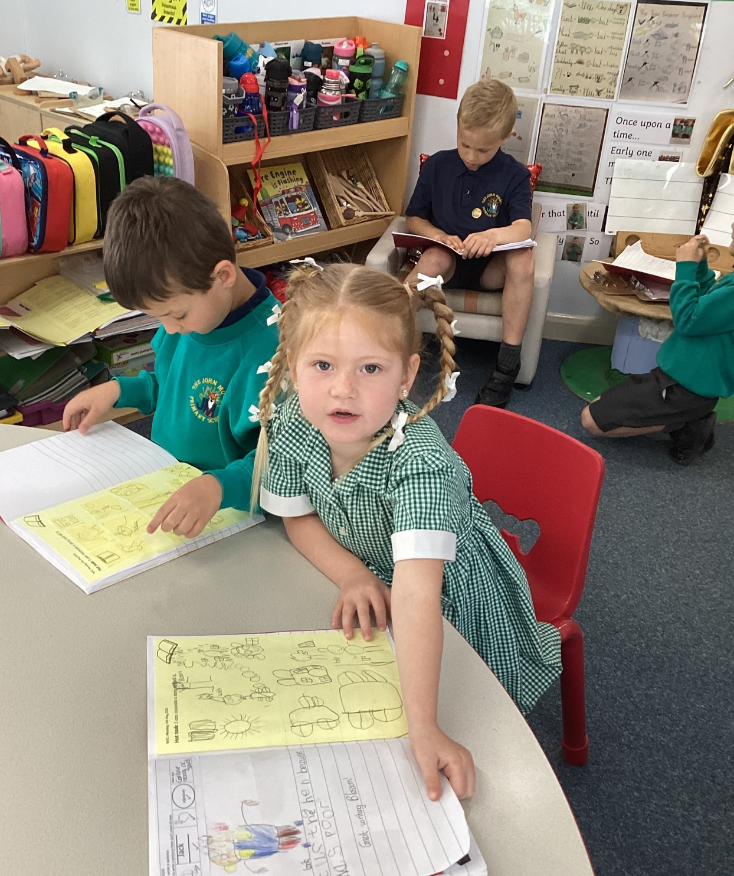
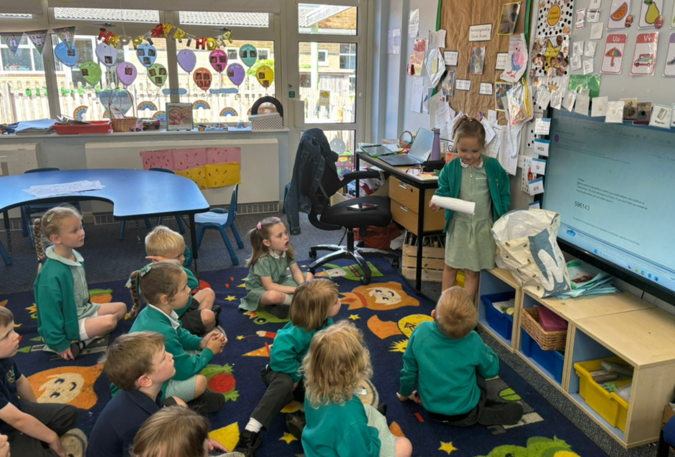
A day in Reception…
8:30-8:45 Arrive at school tabletop activities
8:45-9:00 Register & lunch register
9:00-9:25 Phonics
9:25-10:00 Maths/English (in-put and group activities)
10:00-10:15 Break time
10:15-10:45 Snack and story in class
10:45-11:45 English/Maths (in-put and group activities)
11:45-12:00 Rhymes/story
whilst we get ready for lunch

Slide 13
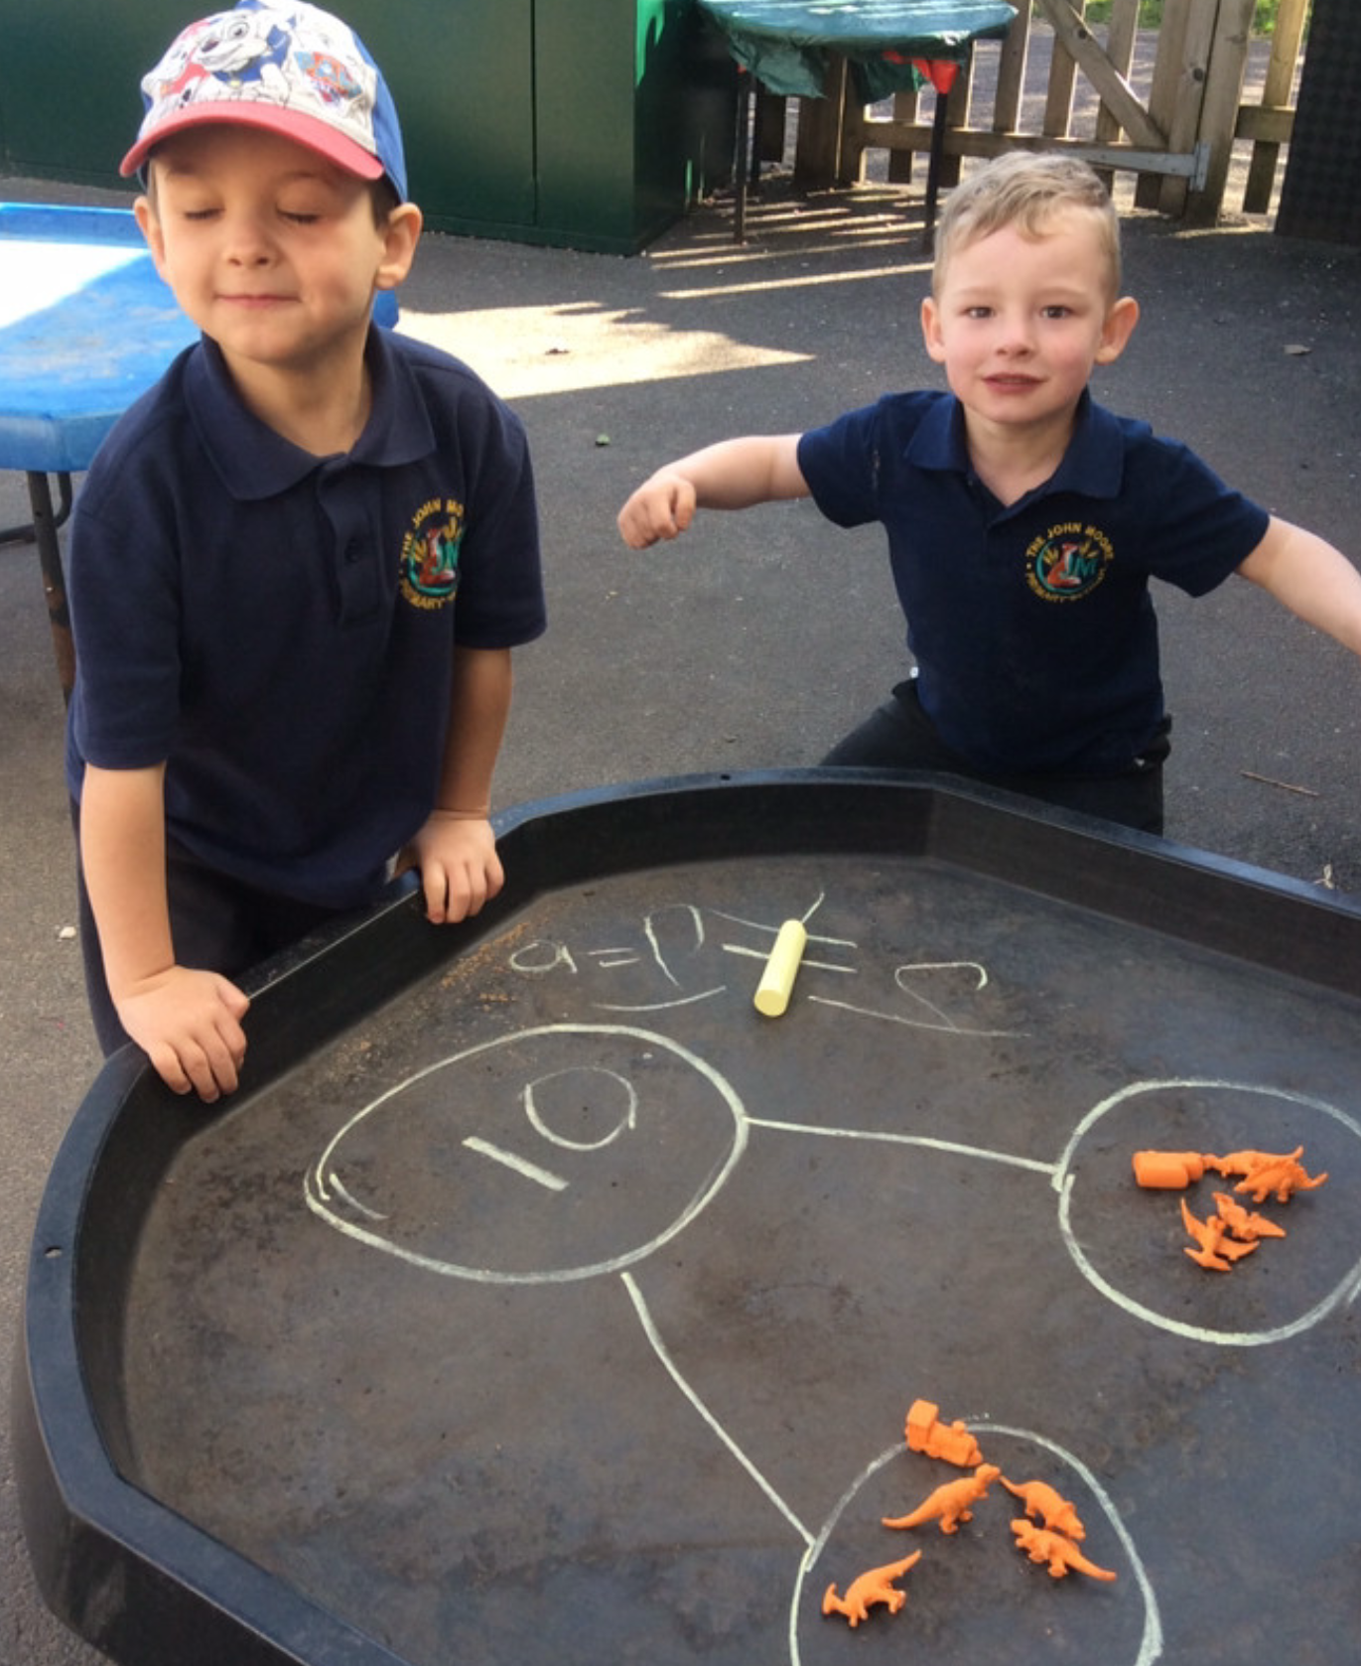
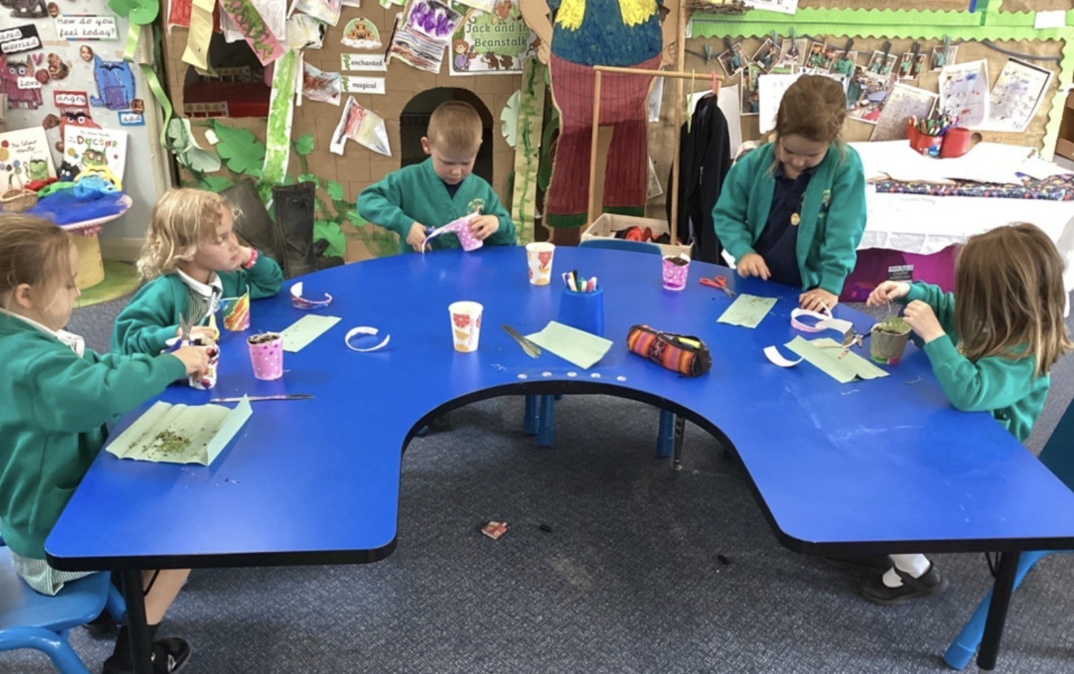
A day in Reception…
12:00-1:00 Lunchtime
1:00-1:10 Register
1:10-1:20 Mini Maths (Short Maths session)
1:20-2:15 Topic & child-initiated learning
2:20-2:35 Snack
2:40-3:00 Assembly
3:10 Home time

Slide 14
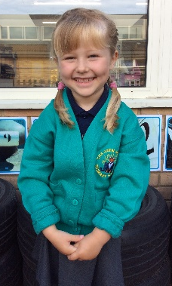
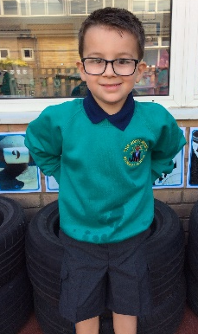
Uniform
NAME ALL ITEMS
We use an online system for ordering
Black shoes
Low heels
No open toe sandals
Wellies
All in one puddle suit
Shoes with Velcro or easy buckles
Elasticated trousers
Skirts / Dresses without complex fastenings
No jewellery, only stud earrings
Slippers – with a good grip on the sole

Slide 15
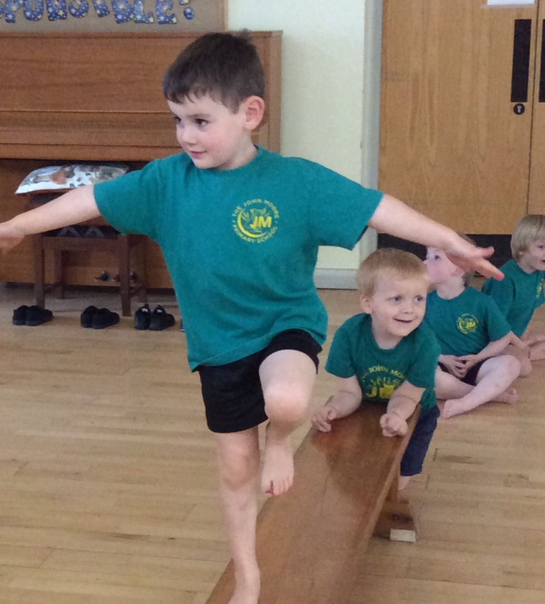
PE kit
Jade T-shirt with school logo & navy shorts
In a PE backpack
All kit named
Earrings:
  Studs only
  On PE days leave out
  Or cover with micropore tape

Slide 16
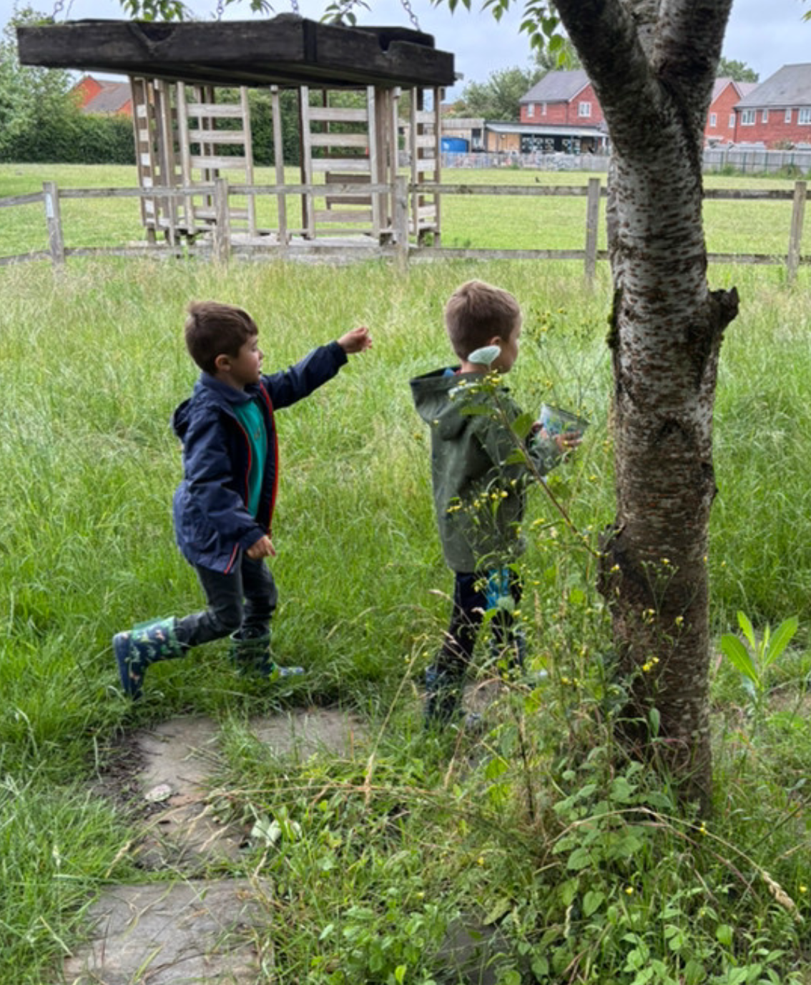
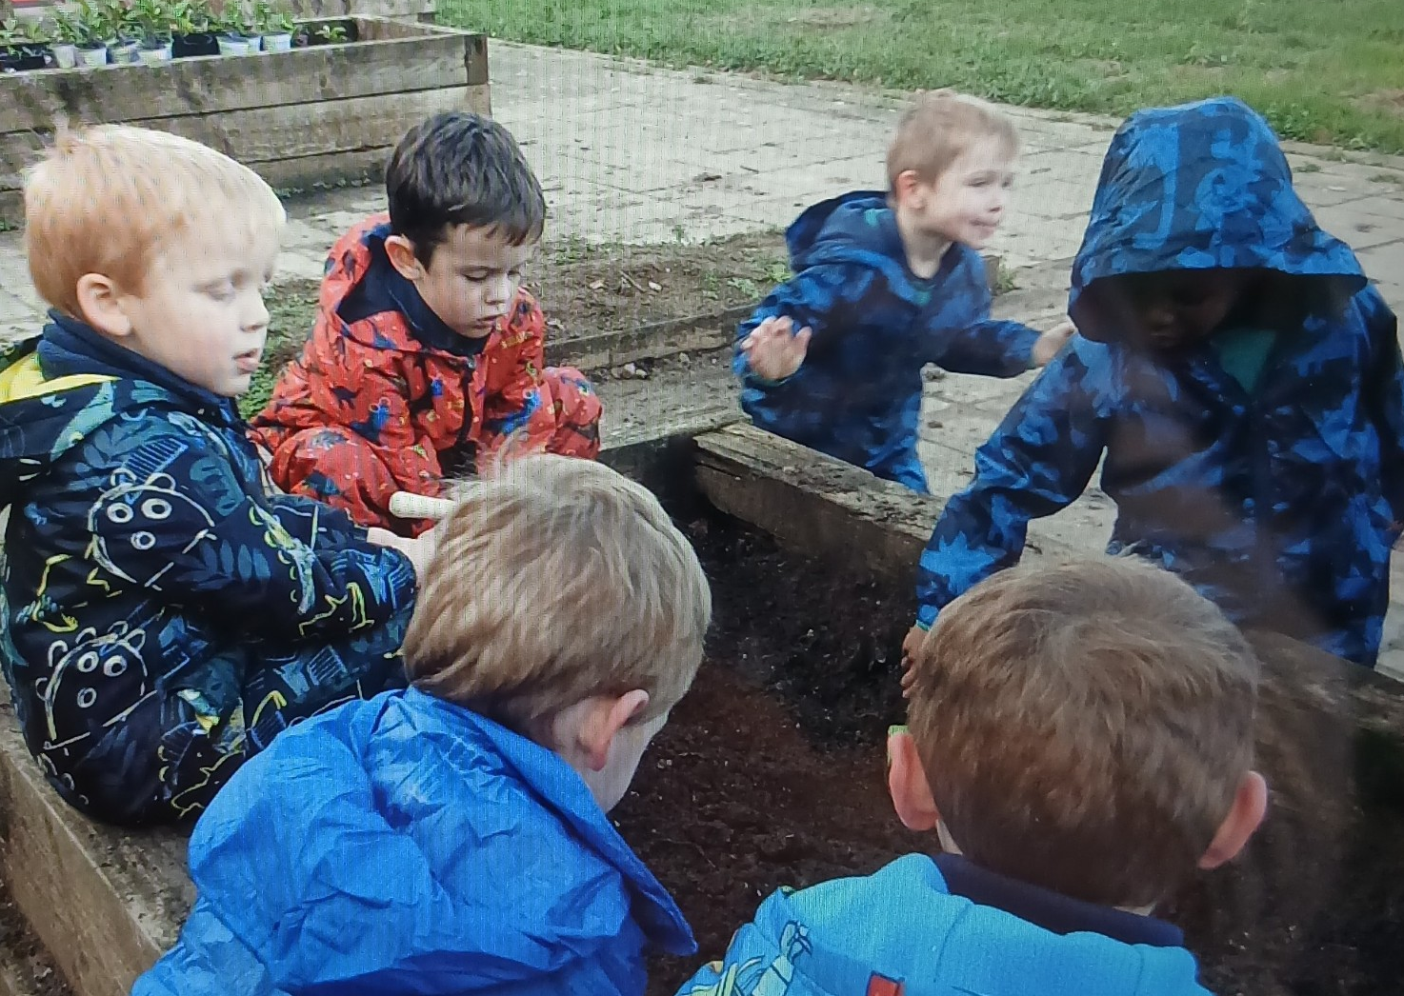
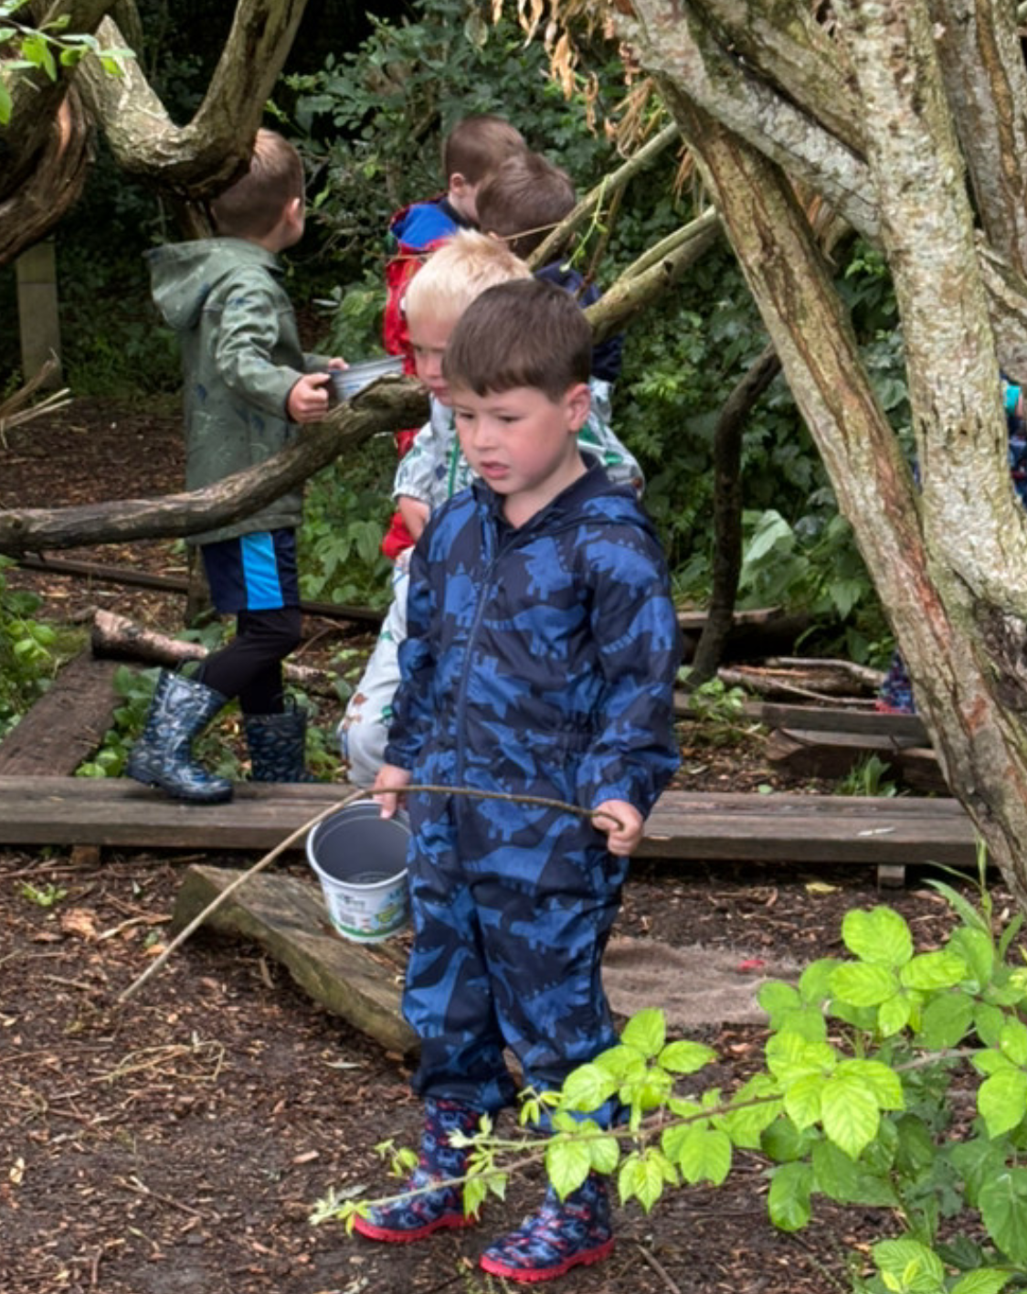
Outdoor Learning
We need to make sure we have our wellies at school!

Slide 17
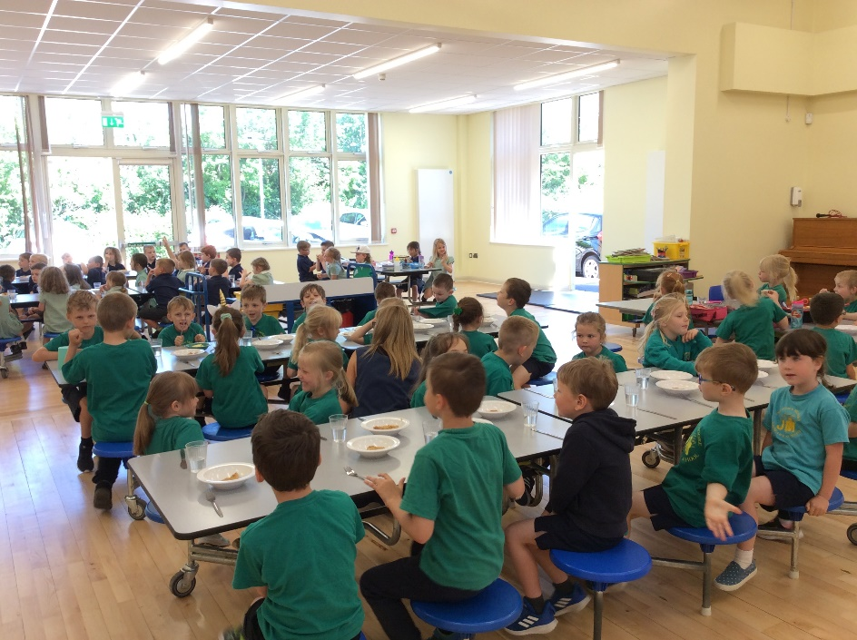
Lunches
Packed Lunch (from home)
Cooked Lunch
Drinks
Water bottle
Milk

Slide 18
Universal Free School Meals
Gloucestershire schools receive free school meals for all Reception, Year 1 and Year 2 pupils. This is in addition to the free school meals service currently offered to pupils whose parents are in receipt of qualifying benefits.
If you are in receipt of qualifying benefits, but don’t want your child to receive a meal, you should still register, so that the school receives as much funding as possible from the Government. By registering you could raise an extra £1,300 to help fund valuable support like extra tuition, teaching assistants, after school clubs, music lessons and sports activities.
There is further information in your packs on how to apply online.

Slide 19
Medicines in School
Inhalers: one to be kept in school
Medicines policy

Slide 20
Security
Health & Safety
Turning circle – is a road
Bicycles and scooters – store in bike shed
Late arrivals – report to office
Collecting children at the end of the day – come to the class room
Absences: telephone (do not use Reach more Parents)
Speaking to the teacher

Slide 21
And Finally…
Book Bag is a gift from The Friends – We will bring these with us on our Home Visits as a gift to the children.
In Autumn term you will be invited into school to gain an insight into the Reception Curriculum. Date to be confirmed.

Slide 22
Any Questions?
If we do not answer your question tonight, please contact the office:
Email: admin@johnmoore.gloucs.sch.uk
Telephone: 01684 291661
Thank you for joining us.
We hope that you and your children will enjoy being a part of The John Moore Primary School family over the coming years.

